Slide 1
the agile-Scrum framework

Slide 2
Agenda
What is Scrum?
Scrum Roles
Scrum Process, in detail

Slide 3
What is scrum
“Scrum is a framework for developing complex products and systems. It is grounded in empirical process and control theory. Scrum employ an iterative and incremental approach to optimize predictability and control risk.”
-- Ken Schwaber

Slide 4
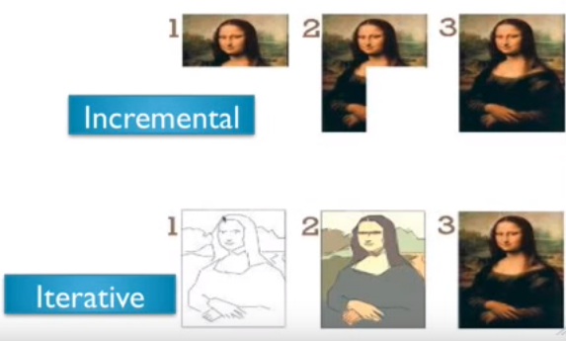
Iterative and incremental . . .

Slide 5
Scrum overview

Slide 6
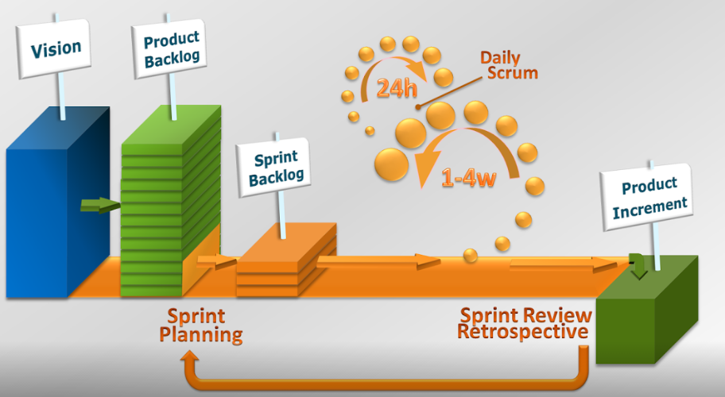

Slide 7
Scrum roles & processes

Slide 8
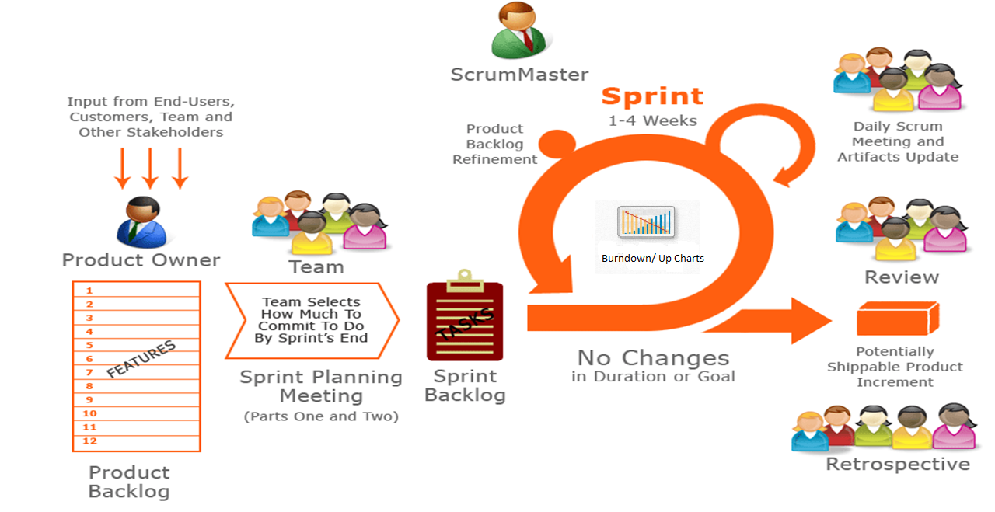

Slide 9
Product Owner decides what should be produced so as to achieve success
Gets Inputs from end users, team managers, stakeholders, executives, industry experts etc
Produces the product backlog which contains the features of the product to be produced in order of priority

Slide 10
The product Backlog is the single master list of features, functionality etc ordered based on business value and risk
The Product Backlog is constantly being revised by the Product Owner, to maximize the business success of the team’s efforts

Slide 11
Ideally consists of 7 +/-2 people
The team has to be cross functional – containing members from the different verticals required for developing the product
The team is self organizing and self managing – makes a commitment and manages its responsibilities

Slide 12
Sprint is referred to the fixed period of time the team commits to work in course of developing the product
The length of the sprint is decided by the Team and the Product Owner
Working at a sustainable pace is important to avoid burn out

Slide 13
Before each Sprint the team selects what it will commit to deliver by the end of the Sprint
The team creates a task-level plan for how they will deliver
The team works together to create an initial assignment of task and compares total estimated task hours with total estimated
Everyone on the team takes part regardless of experience-level

Slide 14
During the Sprint what the team committed to deliver does not changer and the end-date of the Sprint does not change
This enables team to make and keep commitments, it gives the team focus and stability during the Sprint and it trains Product Owner to clearly think through what is on the Product Backlog
If something major cames up, Product Owner can direct the team to terminate the Sprint permanently and start a new one.

Slide 15
Each day, the team has a short meeting to update each other on progress and the blocks. They stand up to keep it fast
To keep the meeting <15 minutes, everyone reports just 3 things done since yesterday, done by tomorrow and blocks
Scrum Master notes blocks and afterworks helps resolve them

Slide 16
Each day, the team updates simple charts that make visible how they are progressing toward their goal for the Sprint
The Sprint Backlog lists all the tasks and the hours remaining for each, The Burndown Chart graphs the total hours left for all tasks. The Task Board shows where tasks are in progress
These charts enables the team to successfully self-manage and deliver what they committed by the end of the Sprint

Slide 17
The Scrum Master is a new role. It can be played by an existing person
The Scrum Master serves the team(helping them remove any and all impediments and surface), protects the team(from any outside disruption or interference), and teaches and guide the team’s use of Scrum
Without a Scrum Master, the team has a high risk of failure

Slide 18
At the end of the Sprint, the Product Owner, Team, Scrum Master and Stakeholders come together and see a demo of what the team has produce
The Product Owner gathers feedback from everyone on ways to improve what’s been built
The feedback is incorporated into the Product Backlog

Slide 19
The aim for the team is to complete 100% of what they committed to, ideally an increment of Potentially Shippable Product at the end of each Sprint
For software, this means functionality that has been designed, fully implemented and fully tested with no major defects

Slide 20
The Team, Product Owner and Scrum Master meet at the end of each Sprint to review their way of working and look for ways to improve their effectiveness
This is the mechanism for continuous improvement and also where critical problems are identified and addressed or surfaced to management for assistance

Slide 21
Summary
It is an iterative, incremental framework
Sprints – cycles of work developed, duration: 2-4 weeks occur after another without pause
Time boxed – they end whether or not the work ends
At the beginning, cross-functional team forms the priority list based on customer requirements
During the sprint the chosen items do not change
Everyday inspection and adjustment
End of the sprint, review with stakeholders
Feedbacks are taken and incorporated into the sprint
End of sprint, fully tasted product is formed as per customer requirements

